Slide 1
Lecture 2 Data Cleaning & Integration
Dr. Amira Rezk
dramirarezk@gmail.com
Sara S. Elhishi
sarashaker161@gmail.com
Information Systems Dept.

Slide 2
The Knowledge Discovery Process
Data Cleaning
remove noise
Data Integration
From multiple Sources
Data Selection
data relevant to the analysis task
Data Transformation
into forms appropriate for mining
Data Mining
extract data patterns
Pattern Evaluation
interestingness measures
Knowledge Presentation
visualization to users

Slide 3
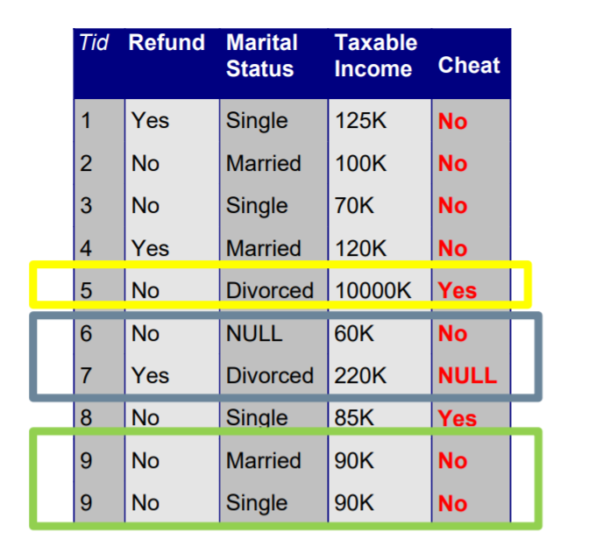
Data Preprocessing
Datasets are highly susceptible to noisy, missing, and inconsistent data.
Low-quality data will lead to low-quality mining results.
Data quality factors includes:
accuracy,
completeness,
consistency,
timeliness,
believability, and
interpretability.

Slide 4
Reasons of Low Data Quality
Inaccurate data
Having incorrect attribute values (e.g., by choosing the default value “January 1” displayed for birthday )
Incomplete data
Missing data (may not always be available or of interest)
Inconsistent data
different assessments of the quality depends on the intended use of the data
Timeliness
(e.g. month-end data are not updated in a timely fashion has a negative impact on the data quality. )
Believability
reflects how much the data are trusted by users
Interpretability
reflects how easy the data are understood (e.g. sales codes)

Slide 5
Preprocessing Tasks That Improve Data Quality
Data cleaning: missing values, noisy data, outliers
Data integration: data from multiple sources
Data reduction: reduced representation of the data set
Data transformation: data scaled to fall within a smaller range like 0.0 to 1.0

Slide 6

Data Cleaning
Missing: empty, null, NaN, or Na (e.g. Occupation=“ ”)
Noisy: contain errors (e.g. salary = “-1000”)
Inconsistent: (e.g. rating was “1, 2, 3”, now rating “A, B, C”)
Intentional: (e.g., by choosing the default value “January 1” displayed for birthday)

Slide 7
Handling Missing Values
Ignore
Ignore the tuple
Fill in
Fill in the missing value manually
Use
Use a global constant to fill in the missing value
Use
Use a measure of central tendency for the attribute to fill in the missing value
Use
Use the attribute mean or median for all samples belonging to the same class as the given tuple
Use
Use the most probable value to fill in the missing value

Slide 8
Note
A missing value may not imply an error in the data!
For example, when applying for a credit card, candidates may be asked to supply their driver’s license number. Candidates who do not have a driver’s license may naturally leave this field blank.
Forms should allow respondents to specify values such as “not applicable.” Software routines may also be used to uncover other null values (e.g., “don’t know,” “?” or “none”)

Slide 9
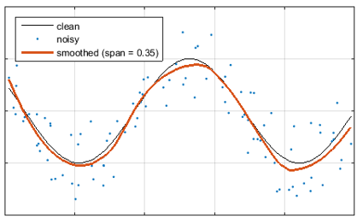
Noisy Data
Noise is a random error or variance in a measured variable.
“smooth” out the data to remove the noise .
Smoothing Techniques:
Binning
Regression
Outlier Analysis (comes later)

Slide 10
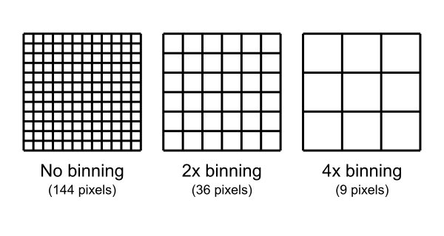
1. Binning
The original data values are divided into “buckets” known as “bins” and then they are replaced by a general value calculated for that bin.
In the context of image processing, binning is the procedure of combining a cluster of pixels into a single pixel.

Slide 11
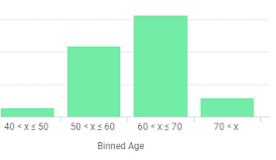
Binning
“Partition” sorted data by 2 methods:
Equal depth (frequency) bins: each bin has same number of values
Equal width bins: interval range of values per bin is equal
“Smooth” each bin by:
bin means: each bin value is replaced by the bin mean
bin medians: each bin value is replaced by the bin median
bin boundaries: each bin value is replaced by the closest boundary value (min & max in a bin are bin boundaries)

Slide 12
Example
Use smoothing to smooth the Age data, Partition them into three bins by
equal-frequency and
equal-width Partitioning
Age: 23, 23, 27, 27, 39, 41, 47, 49, 50, 52, 54, 54, 56, 56, 57, 58, 60, 61

Slide 13
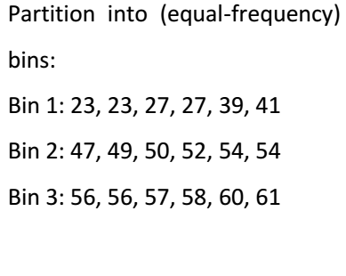
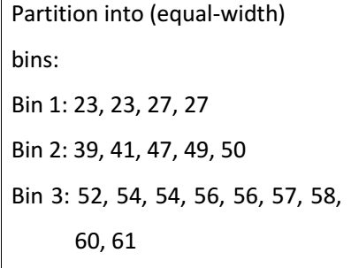
Partition
Age data are first sorted,
23, 23, 27, 27, 39, 41, 47, 49, 50, 52, 54, 54, 56, 56, 57, 58, 60, 61
Partitioned into three equal frequency bins of size 6
Or Partitioned into 3-equal interval bins

Slide 14
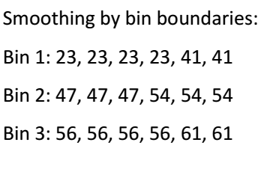
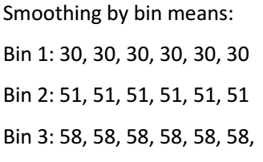
Smoothing (on Equal-frequency)
In smoothing by bin means, each value in a bin is replaced by the mean value of the bin.
In smoothing by bin boundaries, each bin value is then replaced by the closest boundary value.

Slide 15
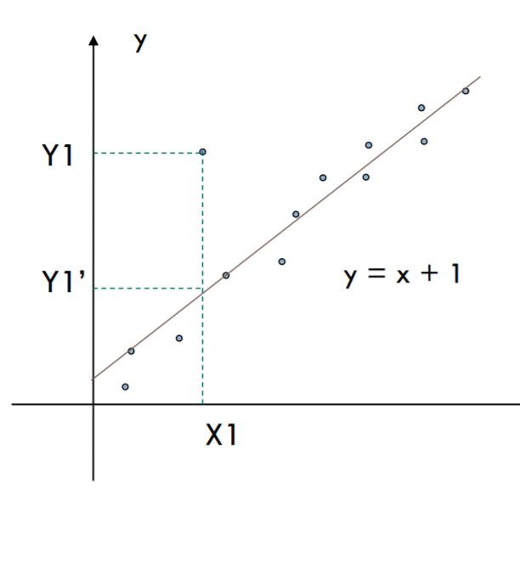
2. Regression
Linear regression involves finding the “best” line to fit two attributes (or variables) so that one attribute can be used to predict the other.
Replace noisy or missing values by predicted values.

Slide 16
Half-Time
Notebook review

Slide 17

Data Integration
Merging of data from multiple data stores.
Careful integration can help reduce and avoid redundancies and inconsistencies in the resulting data set

Slide 18
Entity Identification Problem
How can equivalent real-world entities from multiple data sources be matched up?
For example, how can the data analyst or the computer be sure that customer id in one database and cust_number in another refer to the same attribute?
metadata can be used to help avoid errors in schema integration.

Slide 19
Redundancy and Correlation Analysis
An attribute may be redundant if it can be “derived” from another attribute or set of attributes.
annual revenue, for instance
Correlation analysis, given two attributes, such analysis can measure how strongly one attribute implies the other.
There are 2 test:
Chi-Squre for Nominal Data
Covariance for Numeric

Slide 20
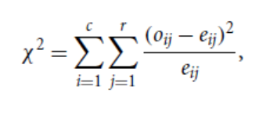
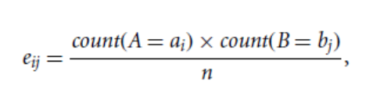

Correlation Test for Nominal Data
a correlation relationship between two attributes, A and B, can be discovered by a $X^{2}$ (chi-square) test
Where $o_{ij}$ is the observed frequency (i.e., actual count) of the joint event ($A_{i}$ , $B_{j}$) and $e_{ij}$ is the expected frequency of ($A_{i}$ , $B_{j}$) which can be computed as
tests the hypothesis that A and B are independent, that is, there is no correlation between them.

Slide 21
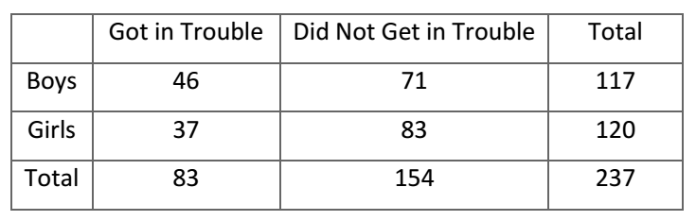
Example
Determine whether there is a relationship between gender and getting in trouble at school (both nominal variables).
The null hypothesis is that the two variables are independent (i.e. no relationship or correlation) and
the research hypothesis is that the two variables are related.

Slide 22
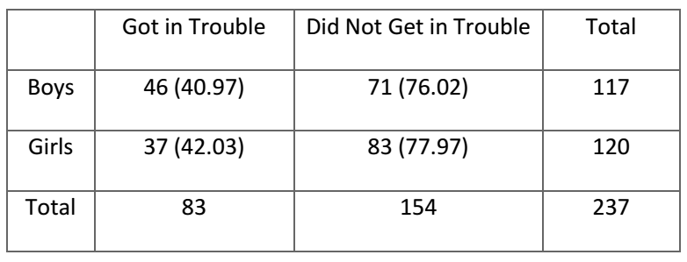
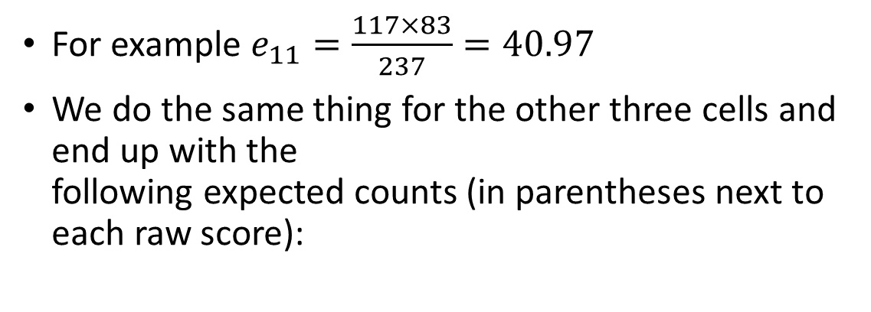
Calculate the expected frequency for each cell
For example $e_{11}=\frac{117×83}{237}=40.97$
We do the same thing for the other three cells and end up with the following expected counts (in parentheses next to each raw score):

Slide 23
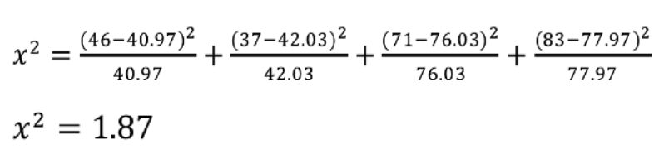
Calculate the chi-square statistic
For each cell, we square the difference between the observed frequency and the expected frequency and divide that number by the expected frequency. Then we add all of the terms
note: a chi-square statistic can’t be negative
before we can come to a conclusion, we need to find our critical statistic, which entails finding our degrees of freedom.

Slide 24
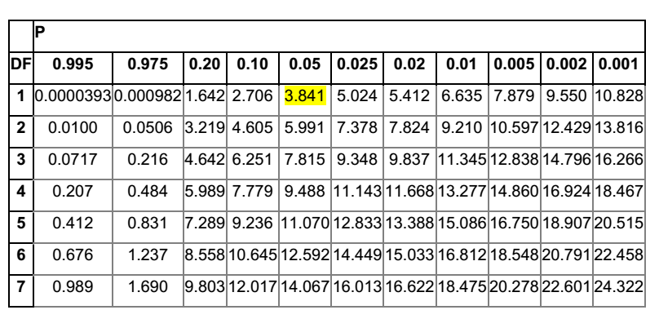
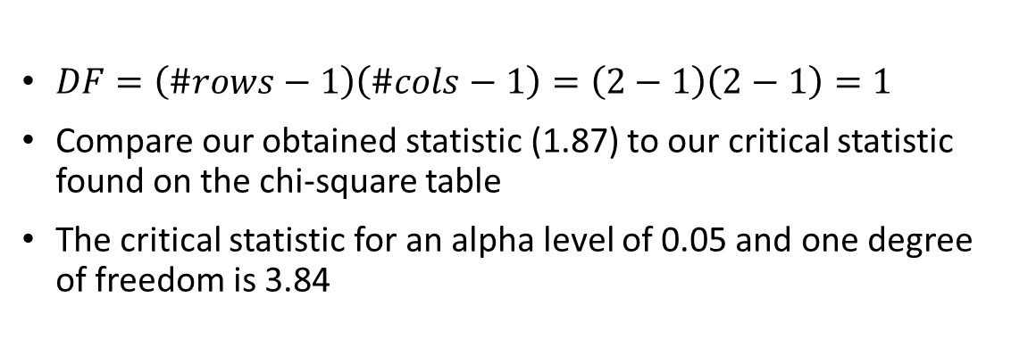
Compute critical statistic
$DF=\left(\#rows−1\right)\left(\#cols−1\right)=\left(2−1\right)\left(2−1\right)=1$
Compare our obtained statistic (1.87) to our critical statistic found on the chi-square table
The critical statistic for an alpha level of 0.05 and one degree of freedom is 3.84

Slide 25
Accept or Reject the Null Hypothesis
Critical (3.841) > obtaind (1.87)
Because the critical statistic is greater than our obtained statistic, we Accept (can't reject ) our null hypothesis.
There is no relationship between gender and getting in trouble at school

Slide 26
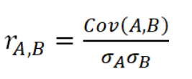

Correlation Coefficient for Numeric Data
The correlation coefficient between two attributes, A and B, is
If $r_{A,B }$is greater than 0, then A and B are positively correlated, The higher the value, the stronger the correlation
If $r_{A,B }$= 0, then A and B are independent
Note that Correlation does not imply causality! That is, if A and B are correlated, this does not necessarily imply that A causes B or that B causes A.

Slide 27

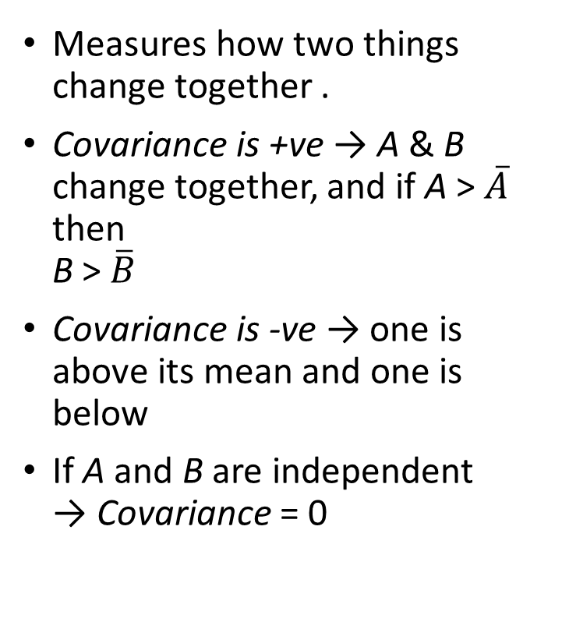
Covariance
Measures how two things change together .
Covariance is +ve → A & B change together, and if A > $\overline{A}$ then B > $\overline{B}$
Covariance is -ve → one is above its mean and one is below
If A and B are independent → Covariance = 0

Slide 28
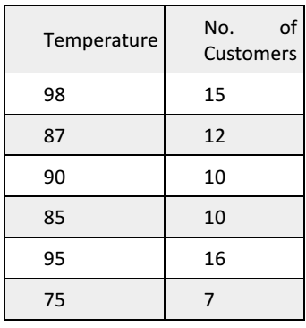
Example
Assume that you gathered data on six different days
Compute Covariance

Slide 29
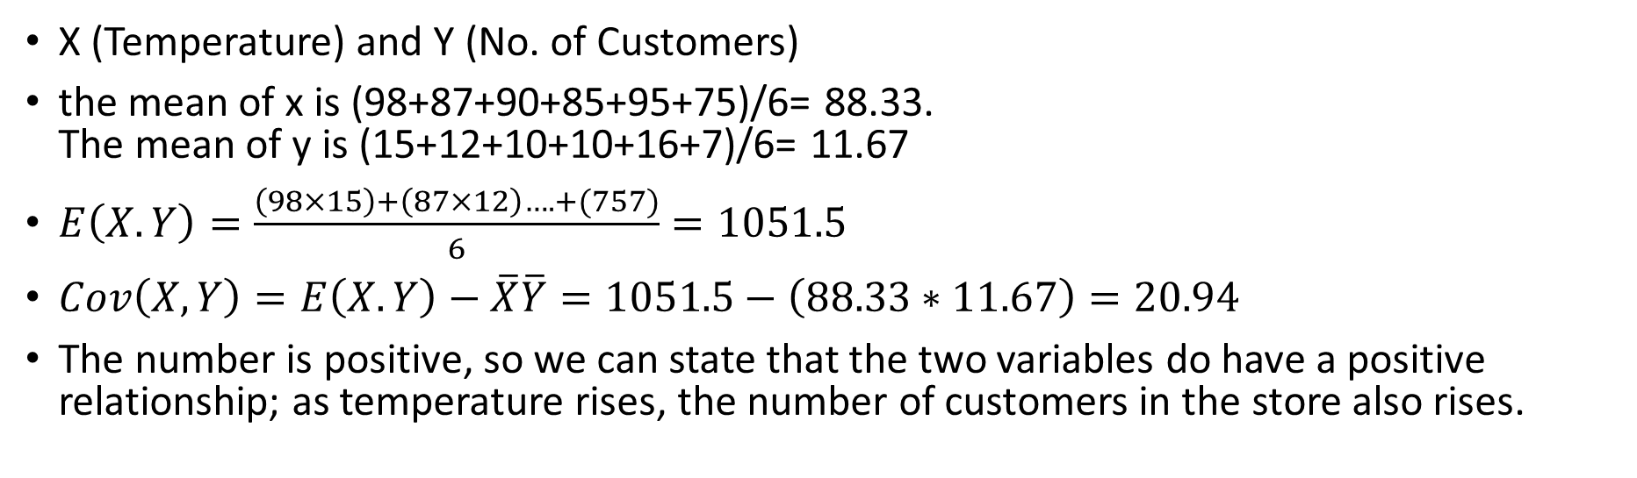
First find the mean of each variable. Then E(X,Y), Finally the Cov(X,Y)
X (Temperature) and Y (No. of Customers)
the mean of x is (98+87+90+85+95+75)/6= 88.33. The mean of y is (15+12+10+10+16+7)/6= 11.67
$E\left(X.Y\right)=\frac{\left(98×15\right)+\left(87×12\right)….+(757)}{6}=1051.5$
$Cov\left(X,Y\right)=E\left(X.Y\right)−\overline{X}\overline{Y}=1051.5−\left(88.33∗11.67\right)=20.94$
The number is positive, so we can state that the two variables do have a positive relationship; as temperature rises, the number of customers in the store also rises.

Slide 30
Thanks

